Slide 1
Operating Systems
Windows, Linux, Mac

Slide 2
Basic Operating Systems
Computers require software to operate
An operating system (OS) is software that coordinates the interaction between hardware and any software applications and the interaction between a user and the computer
Examples are:
Apple’s Mac OS X and iOS
Windows Vista, 7, 8, and 10
Different types of UNIX/Linux
An operating system can be a graphical user interface (GUI) or a command-based (referred to as command line or CLI) interface, or both
It is responsible for handling file and disk management

Slide 3
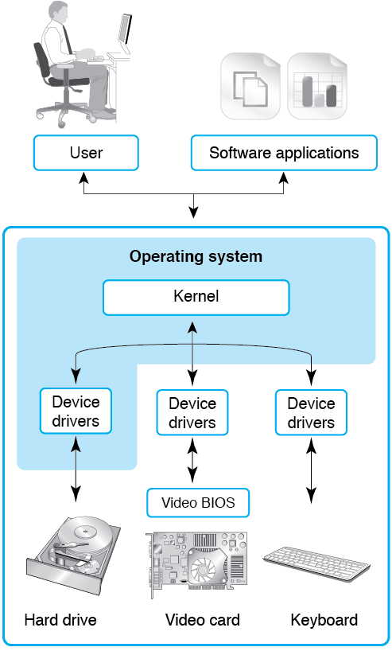
Basic Structure

Slide 4
How Operating System manages memory
The operating system (OS) maps the available memory of connected devices so the CPU can access them through a technique called Memory-Mapped I/O. In this process, certain memory addresses are reserved and mapped to specific I/O device registers, allowing the CPU to interact with these devices as if they were memory locations, controlling and monitoring them by writing to and reading from these mapped addresses.
During system startup, the OS, often with the help of the BIOS or UEFI firmware, identifies the physical memory layout and the resources (including I/O devices) available on the system.
For Memory-Mapped I/O (MMIO), the OS reserves ranges of physical memory addresses to represent the device's control and status registers.
The CPU can then send commands or read status information from the I/O device by simply performing read and write operations to these specific, designated memory addresses.

Slide 5
File systems
File systems are a crucial part of any operating system, providing a structured way to store, organize and manage data on storage devices such as hard drives, SSDs and USB drives.
Popular File Systems
FAT (File Allocation Table): An older file system used by older versions of Windows and other operating systems.
TFS (New Technology File System): A modern file system used by Windows. It supports features such as file and folder permissions, compression and encryption.
ext (Extended File System): A file system commonly used on Linux and Unix-based operating systems.
HFS (Hierarchical File System): A file system used by macOS.
APFS (Apple File System): A new file system introduced by Apple for their Macs and iOS devices.

Slide 6
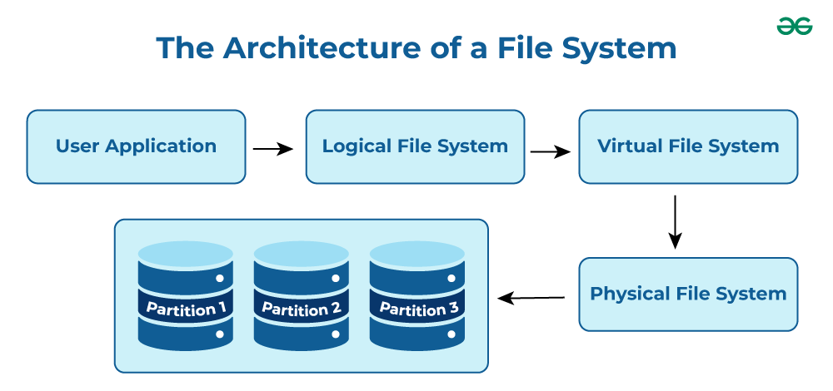
File systems
User Application: The programs or software that request file operations like read, write, or delete.
Logical File System: Manages metadata, file names, directories, and access permissions.
Virtual File System (VFS): Acts as a bridge, allowing different file systems to work under a single interface.
Physical File System: Handles the actual storage of data blocks on the disk.
Partition 1, Partition 2, Partition 3: Divisions of the storage device where files are stored physically.

Slide 7
File systems
A file system manages how and where blocks are read/written to the storage devices.
A block is typically 4K of data by default but can be changed when the file system is added to the storage device (cannot be changed after without reformatting the storage). This is the smallest amount of data that is read or written to the device at 1 time.
Writing files that are smaller than 4k will still take up 4k of space but part of the block will be empty
If you have ever wondered how files get infected with viruses, clever hackers use this empty space to hide their malicious code from anti-virus file size checking utilities
The 4K size was determined to be the best for a balanced file system that would not waste too much space.

Slide 8
File Systems
File systems use many different methods of managing the blocks on a storage device. Most use some form of table in conjunction with directories as well as various allocation methods.
File Allocation Methods
There are several types of file allocation methods. These are mentioned below:
Contiguous Allocation
Linked Allocation(Non-contiguous allocation)
Indexed Allocation

Slide 9
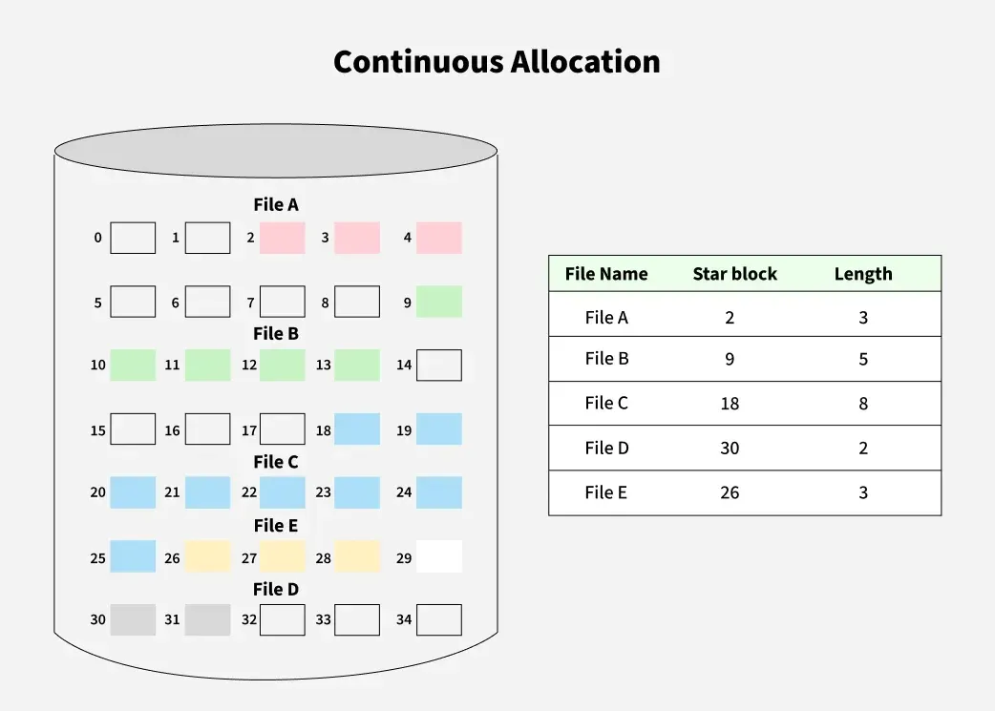
File Systems
Contiguous Allocation
In this scheme, each file occupies a contiguous set of blocks on the disk. This means that given the starting block address and the length of the file (in terms of blocks required), we can determine the blocks occupied by the file. The directory entry for a file with contiguous allocation contains:
Address of starting block
Length of the allocated portion.

Slide 10
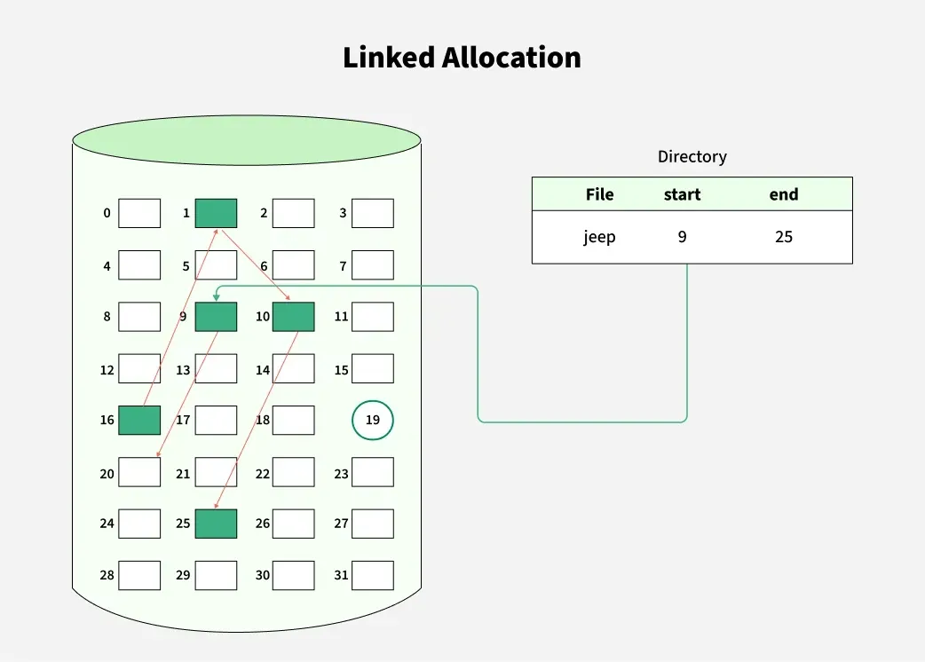
File Systems
Linked Allocation
In this scheme, each file is a linked list of disk blocks which need not be contiguous. Here,
The disk blocks can be scattered anywhere on the disk. The directory entry contains a pointer to the starting and the ending file block.
Each block contains a pointer to the next block occupied by the file.

Slide 11
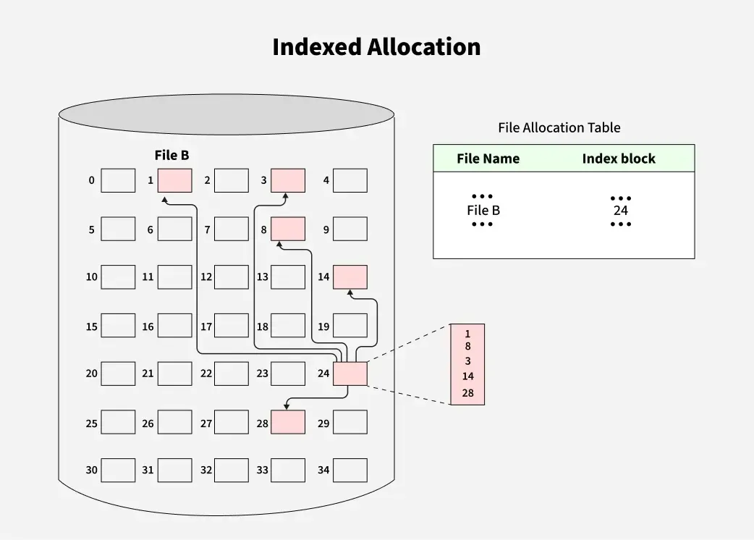
File Systems
Indexed Allocation
In this scheme, a special block known as the Index block contains the pointers to all the blocks occupied by a file. Here,
Each file has its own index block.
The i^{th} entry in the index block contains the disk address of the i^{th} file block.
The directory entry contains the address of the index block as shown in the image.

Slide 12
Processes
In an operating system, a process is an instance of a program that is currently being executed. It is the fundamental unit of work for the OS and includes the program's code, its current activity (like the program counter), and its data. Think of a program as the passive code on disk and a process as that program brought to life and actively running on the computer.
Execution: A process is the active, dynamic entity that follows a sequence of instructions.
Lifecycle: It goes through different states, such as new, ready, running, and waiting, and is eventually terminated.
Resources: When a process is created, the OS allocates necessary resources like memory, CPU time, and file access.
Key Components: A process includes its program code, its data, and a Process Control Block (PCB).
Process Control Block (PCB): This is a data structure used by the OS to manage the process, storing information like the process ID, priority, CPU registers, and memory pointers.
Relationship to Programs: A single program can create multiple processes. For example, opening the same application multiple times will result in multiple processes.

Slide 13
Processes
Similarities across operating systems
Core responsibilities: All operating systems are responsible for managing system resources like the CPU, memory, and devices to provide services for programs.
Process abstraction: They all provide a layer of abstraction to hide the complexity of the hardware, allowing programs to interact with the system through an Application Programming Interface (API).
Basic functions: They all have a process scheduler, memory management, I/O handling, and a way to manage files.
Use of queues: They all use queues to hold waiting processes and use clock cycles to time their execution.
Context switching: They all use context switching to quickly switch between processes, creating the illusion of multitasking.

Slide 14
Summarizing the OS Responsibilities
Now that we know what memory, file systems and processes are let's summarize how the OS manages these resources
Memory management
File management
Process management

Slide 15
Memory management
Allocation and deallocation:
The OS allocates memory to processes when they need it and reclaims it when they are finished, keeping a record of which memory addresses are in use and which are free.
Virtual memory:
When physical RAM (RAM) is full, the OS uses disk space as an extension of RAM. It moves inactive data from RAM to the disk (a process called swapping) to free up RAM for active processes.
Paging and segmentation: These are techniques the OS uses to manage memory.
Paging: Divides memory into fixed-size blocks called pages for efficient allocation.
Segmentation: Divides memory into variable-sized blocks called segments that correspond to logical program divisions like code, data, or stack.
Memory protection:
The OS isolates processes from each other to prevent them from interfering with each other's memory.

Slide 16
File management
File system:
The OS uses a file system (like ext4 or NTFS) to organize data on storage devices, providing a structure for naming, storing, and retrieving files.
Directory structure:
It creates a hierarchical structure of directories (or folders) to help users and programs locate files easily.
Tracking and access control:
The OS tracks the location of each file on the disk and manages access permissions to protect files from unauthorized access or modification.
Interaction with devices:
The OS communicates with storage devices through device drivers to perform read and write operations.

Slide 17
Process management
Process creation and termination:
The OS manages the entire lifecycle of a process, from its creation to its termination.
Process Control Block (PCB):
The OS maintains a data structure called a PCB for each process. The PCB stores essential information about the process, such as its ID, state (running, waiting, etc.), and memory and CPU registers.
Scheduling:
The OS uses a scheduler to determine which process gets to run on the CPU and for how long, ensuring fair and efficient use of the CPU.
Context switching:
When the OS switches the CPU from one process to another, it saves the state of the current process (stored in its PCB) and loads the state of the next process.

Slide 18
OS Interfaces
CLI and GUI

Slide 19
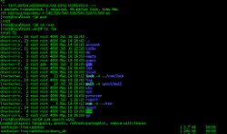
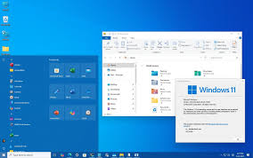
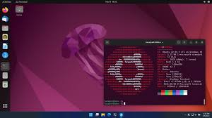
CLI (command line) VS. GUI (Graphical User Interface)
CLI (Command Line Interface) uses text commands to interact with a computer, while GUI (Graphical User Interface) uses visual elements like icons, menus, and buttons. GUIs are generally more intuitive for beginners, while CLIs offer more power, speed, and control for complex tasks and advanced users.
Most modern Operating systems include both a CLI and a GUI
Command Line
Windows GUI
Linux GUI

Slide 20
Desktop Features and Use Case
A comprehensive comparison of operating systems involves understanding the key features and primary use cases of the major platforms. The info on the following slides pertains to Desktop Computers.
Feature | Microsoft Windows | Apple MacOS | Linux )Ubuntu, Fedora, etc.)
Interface | Familiar, user-friendly graphical user interface (GUI) with a Start menu and taskbar. | Elegant, intuitive GUI with a dock and menu bar. The design is a core element of the experience. | Varies significantly by distribution (distro). Some, like Ubuntu, are user-friendly, while others offer deeper customization for experienced users.

Slide 21
Desktop Features and Use Case
Feature | Microsoft Windows | Apple MacOS | Linux )Ubuntu, Fedora, etc.)
Cost | Licensing fees are tied to hardware purchases. Pricing varies between Home, Pro, and Enterprise versions. | Bundled with Apple hardware, but the hardware itself is generally more expensive than Windows PCs. | Free and open-source, though some commercial distros and paid support are available
Hardware | Runs on a vast array of devices from many different manufacturers, offering wide flexibility in hardware choices and price points. | Exclusive to Apple's own hardware, ensuring tight integration and optimized performance. | Can be installed on a wide range of hardware, including older machines, but some specialized or newer peripherals may have limited driver support.

Slide 22
Desktop Features and Use Case
Feature | Microsoft Windows | Apple MacOS | Linux )Ubuntu, Fedora, etc.)
Software | Dominant software ecosystem with the widest availability, especially for gaming and business applications. | Strong support for creative professionals, with exclusive software like Final Cut Pro and Logic Pro. Fewer overall apps compared to Windows. | Huge library of open-source software, but commercial software support can be limited. Developers value its powerful tools and compatibility.
Security | Most targeted OS due to its large user base. Microsoft has improved security significantly with regular updates and built-in antivirus. | Strong security features and less frequently targeted due to a smaller market share. Its closed ecosystem helps minimize vulnerabilities. | Highly secure and stable due to its open-source nature, with vulnerabilities often addressed quickly by the community.

Slide 23
Desktop Features and Use Case
Feature | Microsoft Windows | Apple MacOS | Linux )Ubuntu, Fedora, etc.)
Customization | Offers some customization, such as themes and taskbar settings, but is less flexible than Linux. | Limited customization compared to Linux, as Apple focuses on a consistent user experience. | Extremely customizable, allowing users to modify almost every aspect, from the desktop environment to system resources.
Use Cases | General users: Broad compatibility for home and office tasks. Gaming: Best-in-class support for a wide range of titles and hardware. Business: Extensive enterprise support and productivity tools. | Creative professionals: Strong performance for media creation (design, video, music). General users: Simple and intuitive experience for those in the Apple ecosystem. | Developers and programmers: Strong command-line interface and flexibility. Servers: Dominates the server market due to its stability and efficiency. Tech enthusiasts: Users who value customization and control.

Slide 24
Windows Features

Slide 25
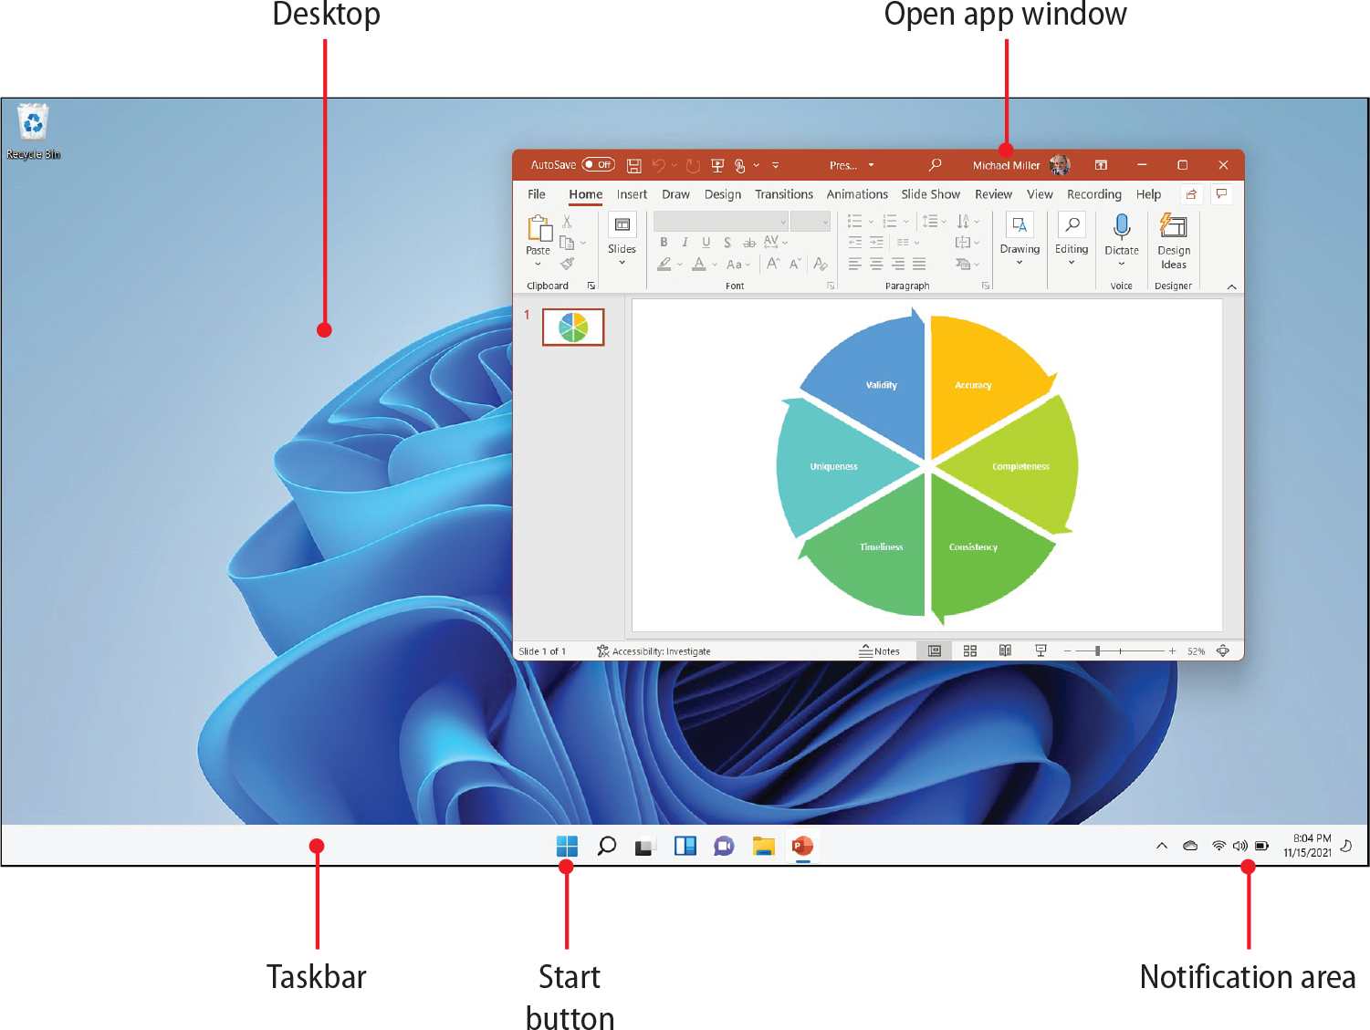
Windows 11 Desktop Components
Windows 11 desktop differs slightly from previous versions of Windows
The Desktop is the area where program Windows will open, it is the main work area.
The taskbar is found at the bottom of the screen. It contains the Start button, the search icon/box, Quick launch/active app icons and the notification area.

Slide 26
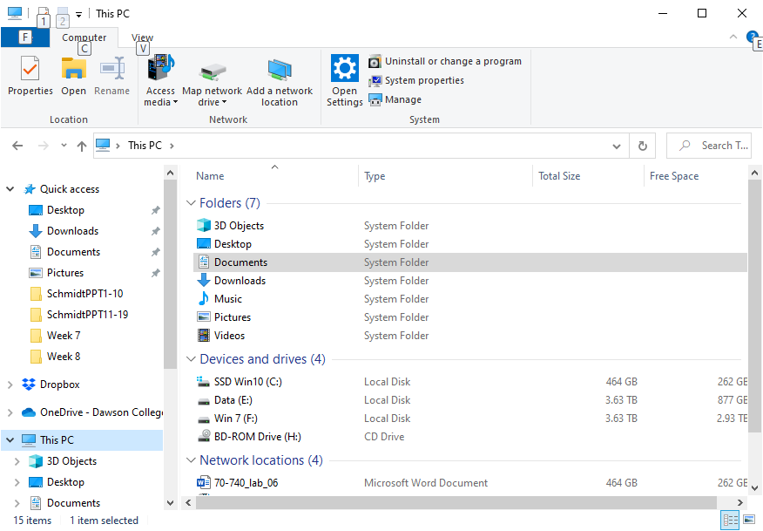
Managing Windows Files and Folders
Technicians often create, delete, and move files and folders
Do these tasks quickly and without error
Each drive in a computer is represented by a drive letter followed by a colon
For example, the first hard drive partition is represented by C:. The optical drive, flash drive, and any external drives are each represented by a drive letter followed by a colon
File Explorer (Windows 8/10/11) is used to manage files and folders

Slide 27
Control Panel
The Windows 11 Control Panel is a feature that allows users to view and change system settings through a collection of applets, though it's being phased out in favor of the newer Settings app.
It provides access to a wide range of options, including managing hardware, software, user accounts, and network settings, with some advanced or legacy configurations still only available here.
To access it, search for "Control Panel" in the Start menu or run the control command in the Run dialog (Windows key + R).

Slide 28
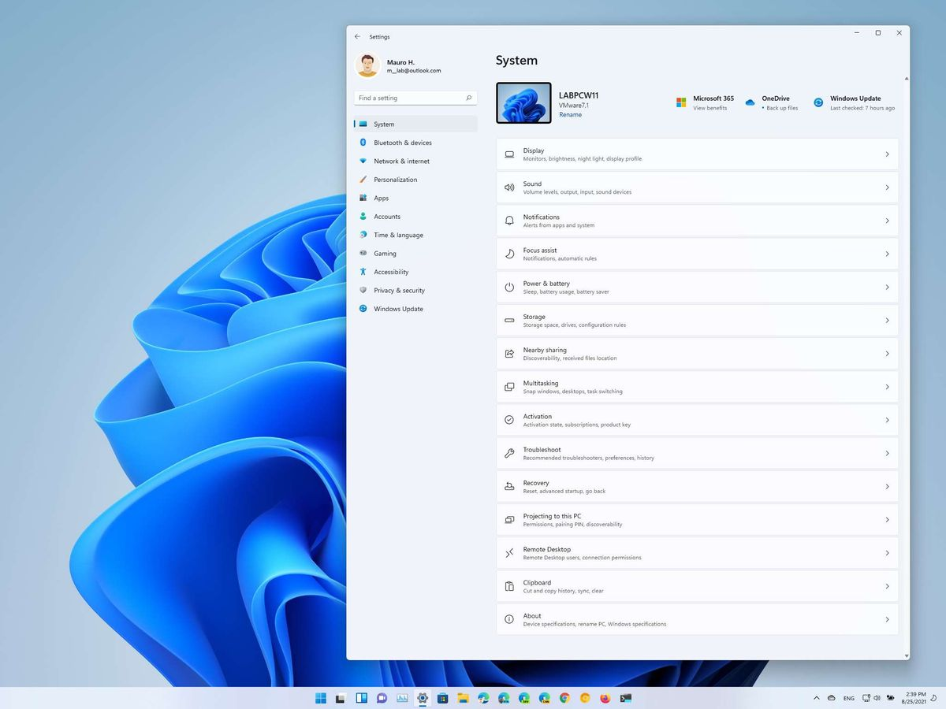
Windows Settings
The Settings app is a central hub for managing your system, allowing you to customize display and sound, manage apps and accounts, adjust network and internet connections, change personalization settings, and update Windows.
You can open Windows 11 settings by searching for "settings" in the Start menu, by using the keyboard shortcut Windows key + I, or by right-clicking the Start button and selecting Settings.

Slide 29
Introduction to macOS

Slide 30
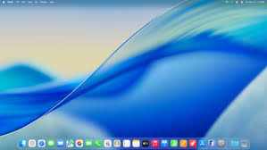
macOS Tahoe
The macOS Tahoe is a Unix-like operating system derived from Darwin, which is based on the FreeBSD and OPENSTEP (NeXTSTEP) operating systems.
While macOS and Linux are both Unix-like and share similarities, they are distinct and incompatible. macOS uses its own kernel, and its proprietary components prevent it from running Linux applications directly, though it has a new feature to run isolated Linux containers.

Slide 31
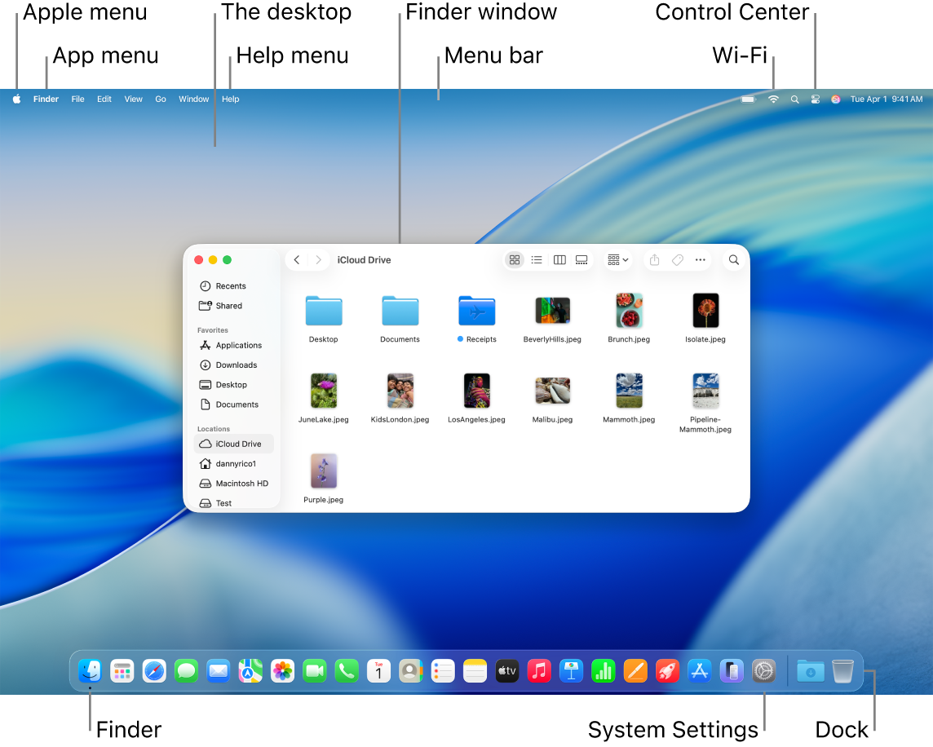
Navigating the User Interface
In macOS Tahoe, the Menu bar, Dock, and Apple menu serve as foundational elements of the graphical user interface. These features have been updated with the "Liquid Glass" design language, giving them a fresh, translucent, and interactive appearance, while maintaining their classic functionality
The Menu bar is a strip that runs along the top of your Mac's screen. Its contents change depending on which application is currently active. It also contains the system menus, App menus and Live Activiyies
The Dock is a customizable row of icons at the bottom or side of your screen used for launching applications and managing minimized windows.
The Apple Menu is the logo located in the top-left corner of the screen. It is always visible, regardless of which application is active, and provides access to System Management, System Settings and Recent Items.

Slide 32
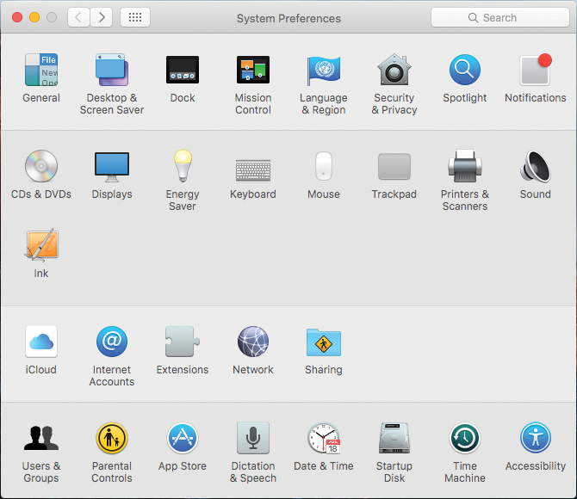
Management and Troubleshooting Tools
The most basic tool is the System Preferences menu
System Preferences is the equivalent to the Control Panels in Windows
It contains most of the system settings such as desktop backgrounds and screen savers, etc.
The System Preferences shortcut by default is located on the Dock, listed in Launchpad or through the Finder
System Preferences Window

Slide 33
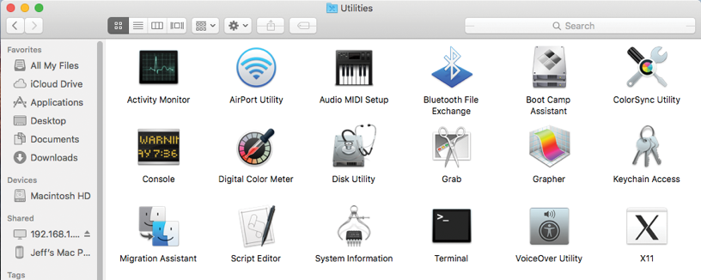
Utilities
Use the tools located under the Utilities director for more advanced system management, maintenance, and troubleshooting
Open Finder
Select the Applications section on the left side of the bar
Go into the Utilities folder
Utilities window

Slide 34
Introduction to Linux

Slide 35
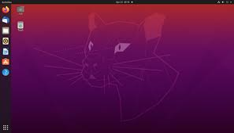
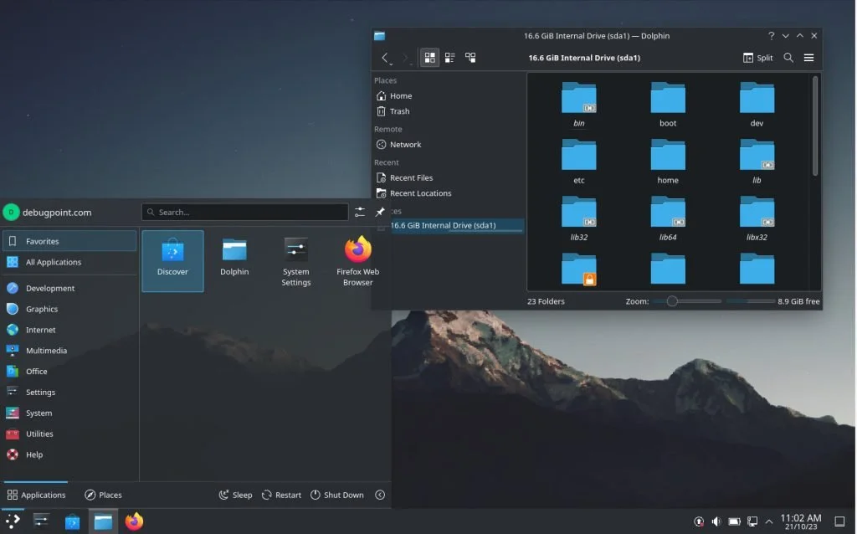
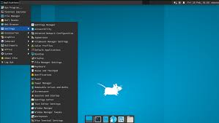
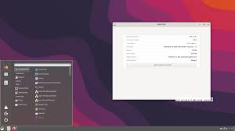
Linux
There are many types of graphical user interfaces for Linux such as GNOME, KDE, Xfce, and Cinnamon
Many “Power Users” like to use the Command Line Interface instead of the GUI
GNOME Desktop version 44
KDE Plasma 5.27 Desktop
Xfce 4 Desktop
Cinnamon 6.2 Desktop

Slide 36
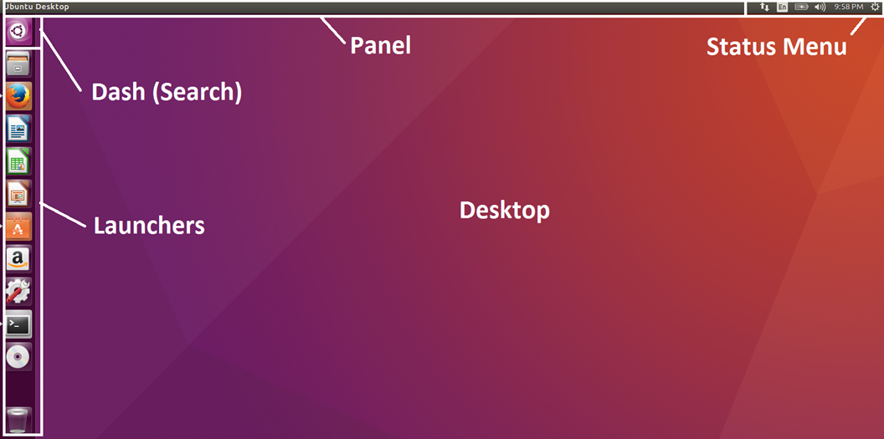
Navigating the User Interface
The panel is a bar or strip, often located at the top or bottom of the screen, that provides quick access to various applications and status indicators. Its content and location are highly customizable.
The search function allows you to quickly find and launch applications, files, and other items on your system. It is a key feature for efficiency, often triggered by pressing a dedicated key (such as the Super key, often the Windows key) and typing your query.
This is a menu or drop-down interface in the panel that consolidates various system status indicators and controls into a single area. It provides a convenient hub for managing your system's state.
Launchers are icons or buttons that serve as shortcuts to quickly start an application or open a file. They can appear in different places depending on the desktop environment.
The desktop is the main workspace area where your windows and icons appear. It is the foundation of the graphical user interface.

Slide 37
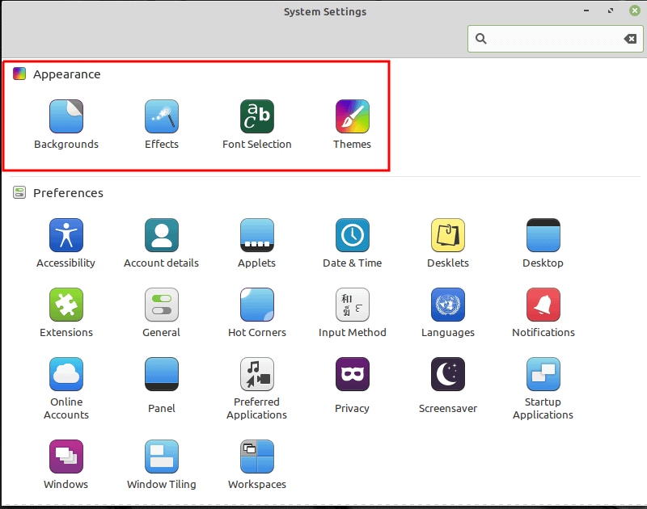
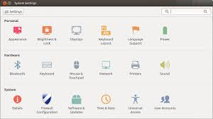
System Settings
Cinnamon System Settings
Cinnamon System Settings
Windows-like feel: Found on popular distributions like Linux Mint, Cinnamon's System Settings offers a classic and straightforward layout that is very comfortable for those transitioning from Windows.
Intuitive: It presents a friendly and organized interface for managing appearance, hardware, and user preferences.
Gnome Control Panel
Streamlined and clean: GNOME's Settings menu is designed to be very clean and easy to navigate, with a focus on simplicity.
Distinct style: The interface has a more modern, phone-like aesthetic compared to Windows, prioritizing user tasks over deep customization.
Gnome Control Panel

